Slide 1


Measures of Centre
AC52012: Research Methods
Notes:
Typically, one of the most popular and straightforward ways of describing our data is with Measures of Centre. In this video we’ll go through what these measures are, how we calculate them, and what they’re good or not so good for.

Slide 2
DESCRIPTIVE STATISTICS
Summarise (describe) our data in a meaningful way (numerically + visually)
Measures of…
- central tendency
- spread
- distribution
Tells us everything about our data
Can’t draw conclusions beyond that data
Notes:
As a reminder, the stats we’re looking at this week and next are DESCRIPTIVE STATISTICS. Although we can’t use them to infer bigger conclusions about a population, these are very important for getting an understanding of the data we have, and these will always be reported in experimental quantitative research. In this first part of the video, we’re going to be looking at measures of central tendency

Slide 3
WHAT IS A ‘MEASURE OF CENTRE’?
A value at the centre (or middle) of a data set
Used to summarise a data set with one value. Including…
Mean
Mode
Median
Midrange
Notes:
A ‘Measure of Centre’ is a value (not necessarily but usually a number) that represents the ‘middle’ of our data set in some way. You may have heard of these if you did any sort of maths at school – they are different ways of making sense of our data from a single value, which is useful for getting a simple understanding of what we’re dealing with. We’ll look at each of these in turn, starting with the mean or more formally the ‘arithmetic mean’.

Slide 4
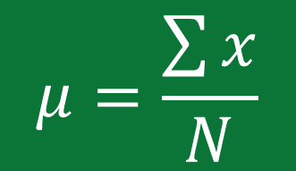
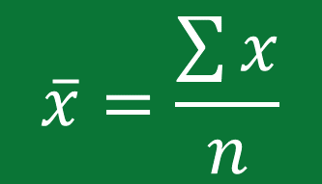
ARITHMETIC MEAN
The measure of centre found by adding the data values and dividing the total by the number of data values.
Properties of the mean:
Sample means from the same population tend to be consistent.
Uses every data value from the sample.
One extreme value can substantially change the mean.
$$\overline{x}=\frac{\sum{x}}{n}$$
sum of all values
$$μ=\frac{\sum{x}}{N}$$
sum of all values
sample mean
population mean
number of values
number of values
Notes:
The mean is the mathematically correct way of saying the ‘average’ of our values. At the bottom here are mathematical representations of what is basically ‘add up all the values and divide by the number of values’. There are two formulae, which will become more important in later weeks, because we need to distinguish between the ‘sample mean’ and the ‘population mean’. Remember our sample is a subset of the population that we’re interested in. It’s usually impossible to know exactly what the population mean is, and so this is estimated from the sample mean.
The mean has a few properties that make it good (or bad) as a measure of centre. A nice benefit is that if we were to take a load of different samples from the same population, the mean is going to be fairly consistent. It also uses every data value from our sample (because we need to add up all the values) and so while this can perhaps provide a more accurate summary of our data, it also means that
an extreme value can drastically change the mean, as I’ll show on the next slide.

Slide 5





IS THE MEAN MEANINGFUL?
mean UK household size = 2.4 people
9
13
20
6
£10,000
£110,000
mean =
12
mean salary = £20,000
Notes:
So in some instances, it may be the case that the mean doesn’t tell us as much as we might like. For example, the mean UK household size is 2.4 people, but it’s unlikely that any given household will have 2.4 people in it for fairly obvious reasons.
As I mentioned before, an extreme value can give us a misleading mean. Let’s say we have 9 people with a salary of £10k and one person with a salary of £110k. The mean salary is £20k, which is double that of most of our sample, and significantly less than the extreme value too.
Finally, just because we CAN compute the mean of our dataset doesn’t make it meaningful. For example, numbers on football shirts don’t represent a quantity – they don’t represent how good the player is or how much they’re worth – they’re just an ID. So computing the mean of them, while possible, doesn’t tell us anything useful.

Slide 6
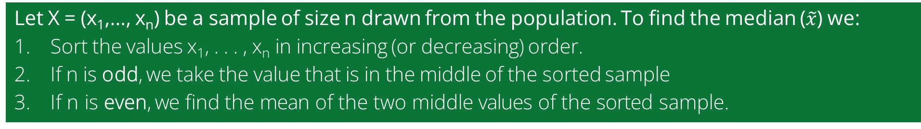
MEDIAN
The measure of centre that is the middle value when the data values are arranged in increasing or decreasing order.
Properties of the median:
Does not change by large amounts when a few extreme values are added.
Does not use every data value
Let X = (x₁,…, x_{n}) be a sample of size n drawn from the population. To find the median ($\tilde{x}$) we:
Sort the values x₁, . . . , x_{n} in increasing (or decreasing) order.
If n is odd, we take the value that is in the middle of the sorted sample
If n is even, we find the mean of the two middle values of the sorted sample.
Notes:
The median is fairly straightforward. If we arrange all our values in order, the median is the number in the middle. So, let’s say we have 21 values, we put them in order, the median is the number with 10 values smaller and 10 values larger.
If we have an even number of values (say 20) then the median is the average of those two middle values.
One beneficial property of the median is that it’s less sensitive to extreme values and skewed data because it does not use all the values in the dataset. If one of our data values was to change from 5 to 5,000,000, the median isn’t going to be changed (or at least not by much) as a result of this.

Slide 7
REVISITNG OUR EXAMPLES
median UK household size = 2 people
9
13
20
6
£10,000
£110,000
median =
11
median salary = £10,000
Notes:
Going back to our previous examples, we can see how the median might provide a more accurate representation of our data. This is especially true when looking at the salaries of our 10 people – arranged in order, the middle value is £10,000 which is a more sensible summary. Our median household size is 2 people, which also represents a real number of people. Again with the football shirts, however, the median doesn’t make a lot of sense to compute. These numbers are categorical data and not actually quantitative.

Slide 8
MODE
The measure of centre that is the value occurring most frequently in a dataset.
Properties of the mode:
The only measure of centre that can be used with categorical data.
A dataset can have one mode, more than one mode, or no mode at all.
Count all the value in the dataset. The value that occurs most frequently is the mode.
If more than one value has the same greatest frequency, both values are the mode – the sample is multimodal.
If no value is repeated, the sample has no mode.
Notes:
Finally, the mode is just the most common number in our dataset. This is the only measure of centre that makes sense to use with categorical data. For example, if our data set consists of nationalities, we can’t compute the average or median nationality, but we can find the most frequently occurring nationality.
We can have a ‘multimodal’ dataset if there is more than one value occurring with the same greatest frequency, or indeed no mode at all.

Slide 9
REVISITNG OUR EXAMPLES (AGAIN)
mode UK household size = 1 person
9
13
20
6
£10,000
£110,000
no mode!
mode salary = £10,000
Notes:
To revisit our examples again, the mode of our salaries is £10,000 because that occurs 9 times.
The most common household size is 1 person, which paints a different picture of our household dataset, suggesting that the average household size (2.4) is being skewed by larger families.
And with our football shirts (which are categorical data) the mode is the only value that would be meaningful, but in this case since all values are unique, there is NO MODE here.

Slide 10

MIDRANGE
The measure of centre that is the value midway between the maximum and minimum values in the original dataset.
Properties of the midrange:
It is very easy to compute
It is very sensitive to extreme values
midrange = $\frac{maximum value + minimum value}{2}$
Notes:
Last (and perhaps least) is the midrange. All we have to do to compute this is take the average of our largest and smallest dataset values. This means that, while it’s very easy to compute, it’s also the most sensitive to extreme values, and so in most cases it’s not that useful.

Slide 11

ROUNDING-OFF RULES
If we need to round the result for a measure of centre…
For the mean, median and midrange, round to one more decimal place than is present in the original set of values.
For the mode, leave the value as is without rounding.
8
13
20
6
$\overline{x}$ = 47/4 = 11.75
= 11.8 rounded to one more decimal place than in the original values (0)
Notes:
When we’re computing these different stats, there are some rules for rounding that we need to do.
For everything apart from the mode, the rule is that we round to one more decimal place than is present in the original set of values.
So, for example, computing the mean of our football shirts results in 11.75. Because there are 0 decimal places in the original dataset, we round this to 1 decimal place. If our values were 8.0, 13.0, 20.0 and 6.0, we would keep it as 11.75.

Slide 12

A CHOCOLATE-CHIP EXAMPLE
We want to count the number of chocolate chips in cookies. We are given a sample of seven counts for seven different cookies. The sample is
X = (22, 22, 26, 24, 23, 27, 25).
Find the mean, median, mode and midrange for the given sample.
Notes:
(Example solution in the video)

Slide 13
Measures of Variation
AC52012: Research Methods
Notes:
In this video I’ll also talk about measures of variation. These measures are perhaps the most important in the field of statistics (at least that’s what Triola says in the Elementary Statistics book – and I’m inclined to believe him). While measures of centre can summarise our data in one nice single value, they are limited in their ability to tell us how the data is ‘spread’ or ‘distributed’. In our previous examples, the mean salary could be skewed by extreme values, and the differences in mean/mode/median of household numbers show that there is a lot of information that we don’t get from these measures. In the next part of this video, I’ll explain exactly what these measures are, and the most important examples.

Slide 14
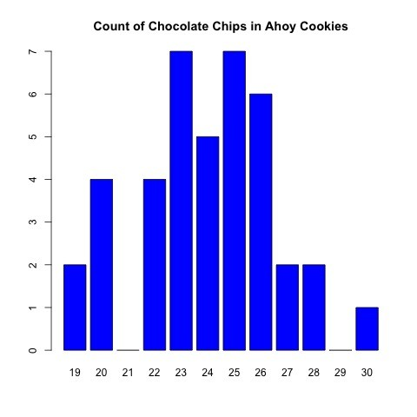
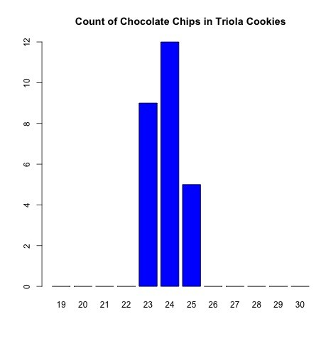
CHOCOLATE CHIP VARIATIONS
Lots of variation
Little variation
Notes:
An example from this textbook nicely illustrates how the mean/mode/median are insufficient to tell the whole story of our data. In both of these examples, the mean is approximately 24 for both, the median is 24 for both, and the mode is 23/25 for the left dataset, and 24 for the right dataset. Yet we can intuitively see from these charts (histograms by the way) that there is a lot more variation in the left sample than in the right.

Slide 15
WHAT IS A ‘MEASURE OF VARIATION’?
A value representing how ‘spread out’ our data is
Used to summarise a data set with one value. Including…
Range
Standard deviation
Variance
“the single most important topic in statistics”
- Triola, Chapter 2
Notes:
And this is exactly what measures of variation are for – they tell us just how ‘spread out’ our data is, which we just don’t get from measures of centrality. As I mentioned, Triola cites measures of variation as the single most important topic in statistics, and indeed measures of variation (particularly standard deviation) are always reported in quantitative research because they give anyone unfamiliar with the data a much clearer idea of the distribution of our values around a central point (i.e., the mean or median). We’ll go through each of these measures in turn.

Slide 16
RANGE
The measure of variance that is the difference between the highest and lowest values in a dataset
Properties of the range:
Very easy to compute
Very rarely used
Very sensitive to extreme values
range = maximum value – minimum value
Notes:
Starting with the easiest, the range is simply the maximum value in our data minus the minimum value. This gives us a very basic understanding of the variation in our data, and it’s basically the same as our midrange measure of centre – except the range is slightly better as a measure of variation than the midrange is as a measure of centre.
That said, although both are easy to compute, both are also sensitive to extreme values and so very rarely used in practice, so we can move on from this fairly quickly.

Slide 17
STANDARD DEVIATION
A measure of variance that represents how much the data values of a sample deviate from its mean
Properties of the standard deviation:
The most common measure of variation in statistics
Uses every data value in the sample
Always positive; 0 when all the data values are the same
Can increase dramatically with inclusion of extreme values
Biased estimator of the standard deviation of the population
Formula on the next slide (it’s quite big)
Notes:
And we move on to perhaps the most important of the measures of variation, which are themselves very important. Unfortunately, it’s also a wee bit more complicated! This is the ‘standard deviation’, which is a number that tells us how much our data values are spread out from the average (or mean) value.
Much like the mean, it uses every data value in the sample, and also much like the mean, it is the most common measure of its kind, and it’s sensitive to extreme values.
An important property is that it is a ‘biased’ estimator of the SD of the population. You don’t need to worry about this right now, but basically what it means is that the value we get for the SD of our sample is usually an OVERestimate of the SD of our entire population.

Slide 18
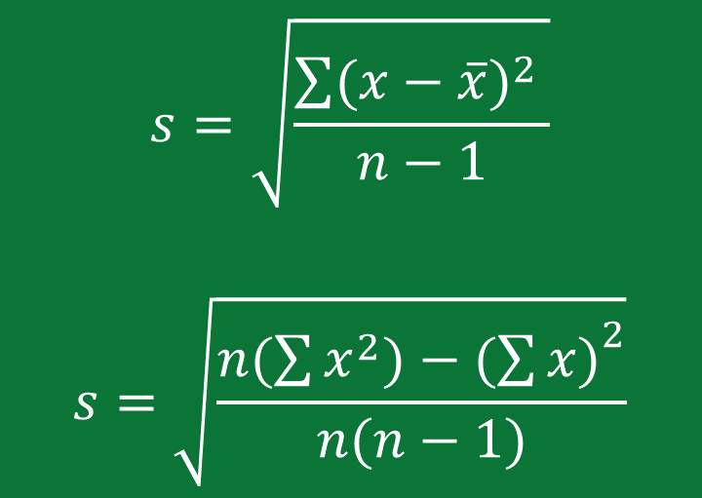
STANDARD DEVIATION – THE FORMULA
A measure of variance that represents how much the data values of a sample deviate from its mean
$$s=\sqrt{\frac{\sum{{(x−\overline{x})}^{2} }}{n−1}}$$
$$s=\sqrt{\frac{n(\sum{x^{2})−{(\sum{x)}}^{2}}}{n(n−1)}}$$
For each value in the dataset, subtract the mean and square the result. Then add them all together.
Higher number = higher deviation from the mean
Another way to calculate it that’s quicker and easier to do
Notes:
As a measure that represents how much the data values deviate from the mean, the first step is to get how much each data value deviates from the mean. This first part of the equation asks us to subtract the mean from each of the values in our sample, then square the result, and then the symbol on the left means ‘add all the results together’.
The ‘n’ stands for the number of values in our sample, so if we have 7 different values, we divide by 6. Then, the SD is the square root of our result.
The formula on top illustrates the principle behind it, but the formula below (although it looks a bit more complicated) is quicker and easier than manually calculating the deviation from the mean of each value.

Slide 19
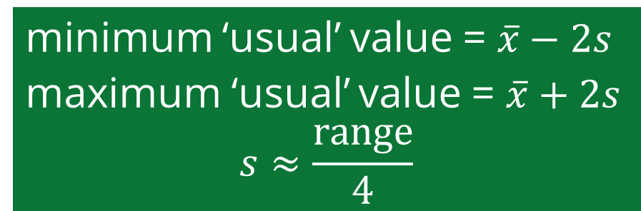
INTERPRETING STANDARD DEVIATION
Rule of thumb: For many data sets, the majority (95%) of sample values lie within 2 standard deviations of the mean.
What does this mean?
Can compute min and max ‘usual’ values if we know the standard deviation
Can estimate standard deviation if we know the maximum and minimum values
minimum ‘usual’ value = $\overline{x}−2s$
maximum ‘usual’ value = $\overline{x}+2s$
$$s≈\frac{range}{4}$$
Notes:
What we find is that, for many of the data sets we deal with, 95% of sample values are within 2 ‘standard deviations’ of the mean. It’s not an exact science, but if we know the Standard Deviation, we can get a very good estimate of the minimum and maximum values. Similarly, if we know the min/max values, we can get a good idea of what the standard deviation ought to be.

Slide 20
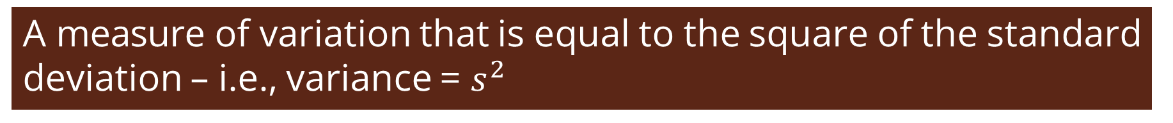
VARIANCE
A measure of variation that is equal to the square of the standard deviation – i.e., variance = $s^{2}$
Properties of the variance:
Uses every data value in the sample.
Always positive; 0 when all the data values are the same
Can increase dramatically with inclusion of extreme values
Unbiased estimator of the variance of the population
Measured in units that are squares of mean and standard deviation units
$$s=sample standard deviation;s^{2}=sample variance$$
$$σ=population standard deviation; σ^{2}=population variance$$
Notes:
Although I’ve been using the term ‘variation’, or ‘spread’ or ‘distribution’, ‘VARIANCE’ is a distinct term that is equal to the square of our standard deviation. So when you took the square root at the end of the SD equation, the variance is just the number you get before you do that.
It has a couple of important properties that distinguish it from the standard deviation. The first is that it is an UNBIASED estimator of the population variance. All that means is that, regardless of the sample you take, the variance of that sample is likely to be a very close estimate of the population variance.
However, it is also measured in different units (i.e., the square of whatever units your measurements are in) which makes it harder to interpret. For example, if our values are in kilograms, then the units of variance are kilograms squared, which is not intuitive. For this reason, the standard deviation is used more frequently in research.

Slide 21
A RETURN TO COOKIES
We want to count the number of chocolate chips in cookies. We are given a sample of seven counts for seven different cookies. The sample is
X = (22, 22, 26, 24, 23, 27, 25).
Find the range, standard deviation, and variance for the given sample.
Notes:
Example in video.

Slide 22

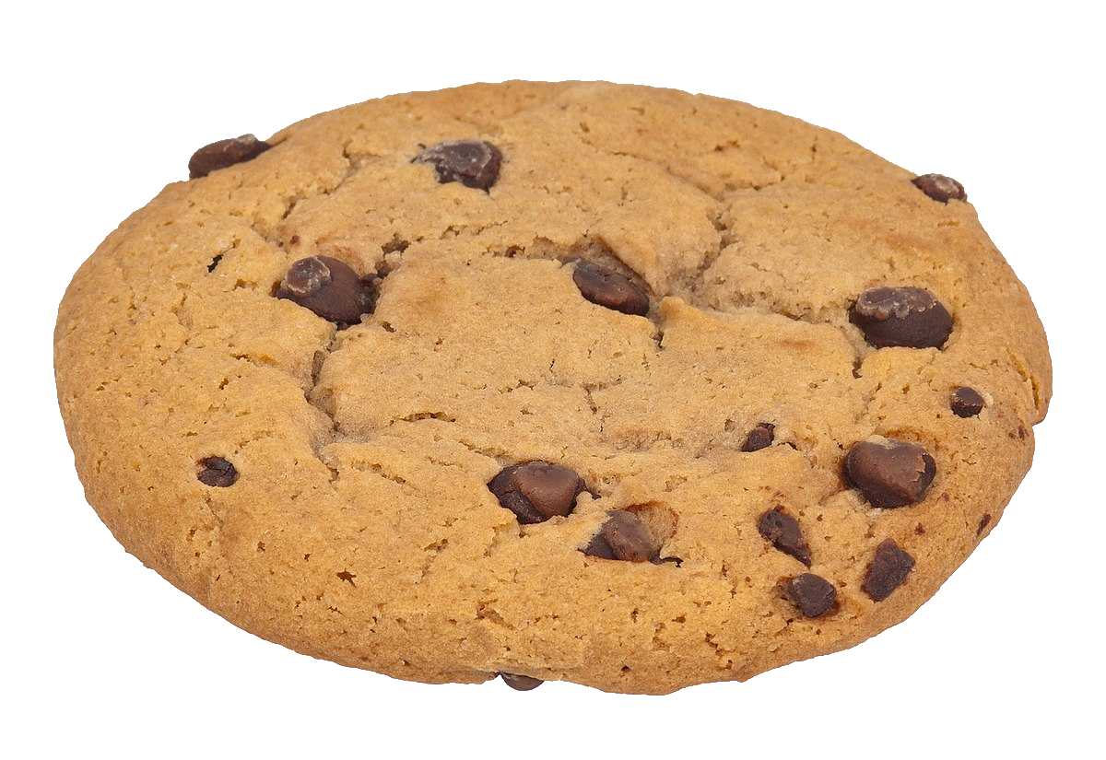
COMPARING VARIATION
Compare two sample standard deviations only when the sample means are approximately the same, and they use the same scale/units.
mean chocolate chips = 24.1
standard deviation = 1.95
mean weight = 0.81672lb
standard deviation = 0.00751lb
Units are different AND means are very different
Notes:
Now, when we want to compare the variation between two different samples (which is something you often want to do in research) it’s only meaningful to do so IF your sample means are approximately the same, and you’re also measuring things on the same scale.
For example, if you want to compare the standard deviation of chocolate chips in a cookie to the standard deviation of Coke can weights, it doesn’t make sense to do so for two reasons. First, the means are very different, and second, the units are different too (you can’t meaningfully compare the number of chocolate chips to a weight in lbs).
What we need is a measure of variation that is relative to the mean. That way, we could say whether there’s more variation in chocolate chips, or more variation in can weight.

Slide 23
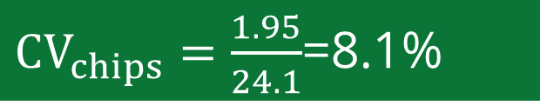
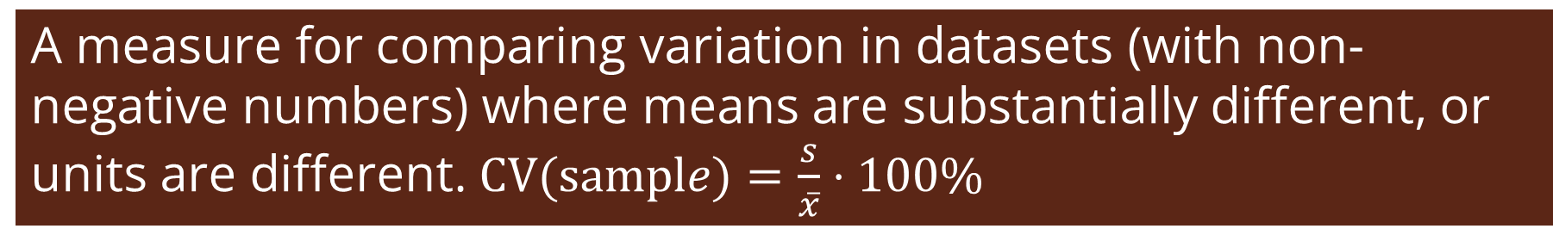

COEFFICIENT OF VARIATION
A measure for comparing variation in datasets (with non-negative numbers) where means are substantially different, or units are different. $CV(sample)=\frac{s}{\overline{x}}⋅100\%$
mean chocolate chips = 24.1
standard deviation = 1.95
mean weight = 0.81672lb
standard deviation = 0.00751lb
${CV}_{chips}=\frac{1.95}{24.1}$=8.1%
${CV}_{weight}=\frac{0.00751}{0.81672}$=0.9%
Notes:
And as it happens, there is a measure for doing so called the coefficient of variation! We can use this to compare two different datasets (provided that neither of them have negative numbers). All you need to do is divide the standard deviation by the mean, and multiply that number by 100 to get a percentage value. In doing so, we can see that the deviation in chocolate chips relative to the mean is substantially more than the weight of the cans.
Intuitively this makes sense, because while a chocolate chip up or down isn’t going to make a noticeable difference, having underfilled/overfilled cans is going to likely upset consumers, and so there needs to be more quality control for this metric.

Slide 24
SUMMARY
Measures of centre are used to summarise data using one value
The most important measure of centre is the mean
Measures of variation are used to quantify the amount of variation in the values of the data set
The most important measure of variation is standard deviation
For comparison of variation between two different populations, we can use the coefficient of variation
Using the above measures, we can understand the data and discover any unusual data values in a dataset
Notes:
And so this video covered quite a lot – the initial title was ‘Measures of Centre’ but we also covered measures of variation too. While all these measures are used in different situations (otherwise there would be no point in covering them) typically we will be making use of the MEAN as a measure of centre, and the STANDARD DEVIATION as a measure of variation.
Using these different measures, we can get a feel for our data and hopefully notice anything unusual about it.
However, we’re not at the end of descriptive statistics just yet. We need to consider measures of ‘relative standing’, i.e., how each data value stands ‘relative’ to the rest of the data, which is covered in the final video of this week.

